Slide 1
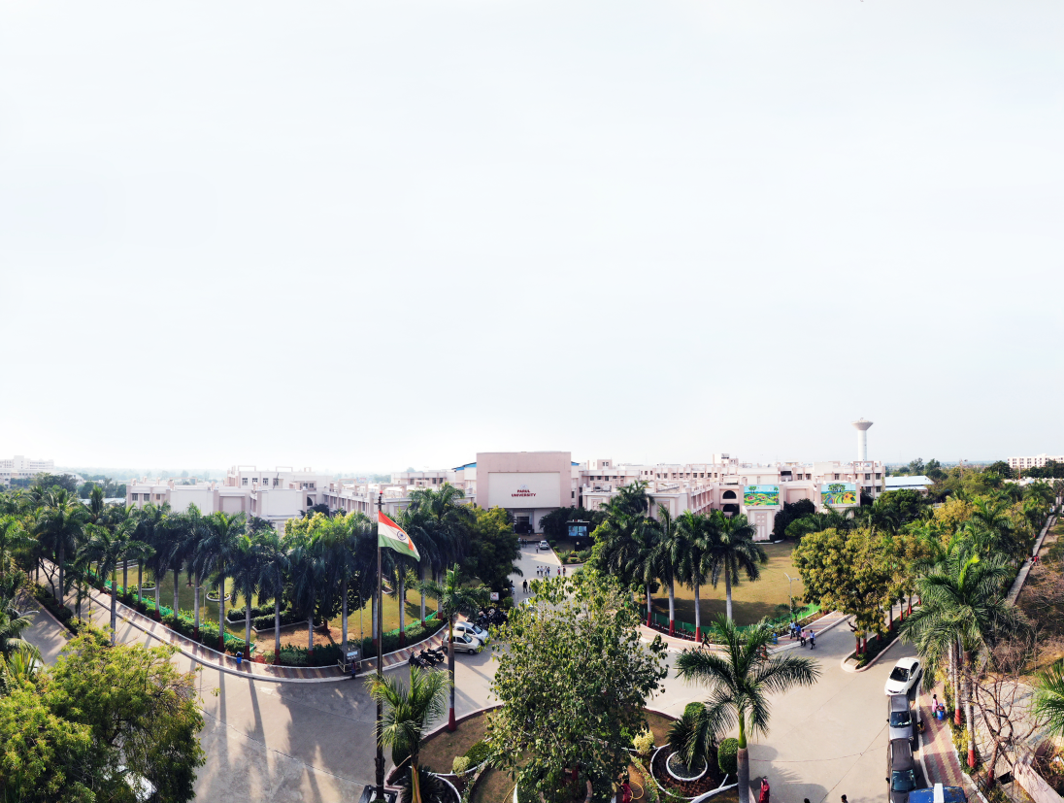


WEB PROGRAMMING (203105353)
Prof. Vaibhav Suryawanshi, Assistant Professor,
DEPARTMENT OF COMPUTER SCIENCE & ENGINEERING

Slide 2


CHAPTER-1
HTML and HTML5

Slide 3
Introduction
HTML is a language for describing web pages.
HTML stands for Hyper Text Markup Language
HTML is not a programming language, it is a markup language
A markup language is a set of markup tags
HTML uses markup tags to describe web pages

Slide 4
HTML Tags
HTML markup tags are usually called HTML tags
HTML tags are keywords surrounded by angle brackets like <html>
HTML tags normally come in pairs like <b> and </b>
The first tag in a pair is the start tag, the second tag is the end tag
Start and end tags are also called opening tags and closing tags

Slide 5
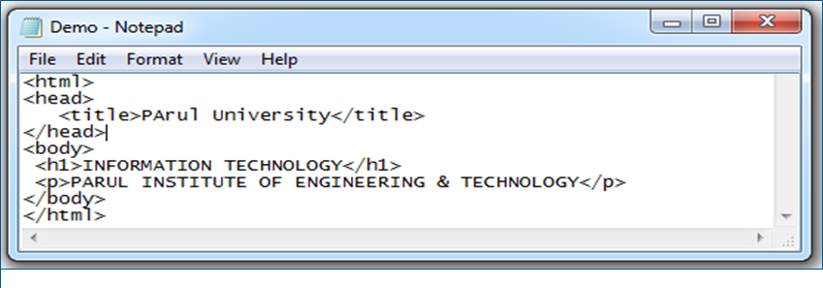
How to create web page?
Step 1: Open Notepad
Click Start (bottom left on your screen). Click All Programs. Click Accessories. Click Notepad.
Step 2: Write HTML Code

Slide 6
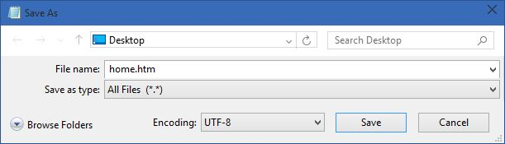
How to create web page?(Contd..)
Step 3: Save the HTML Page
Save the file on your computer.
Select File > Save as in the Notepad menu.
Name the file "home.htm" or any other name ending with htm.

Slide 7
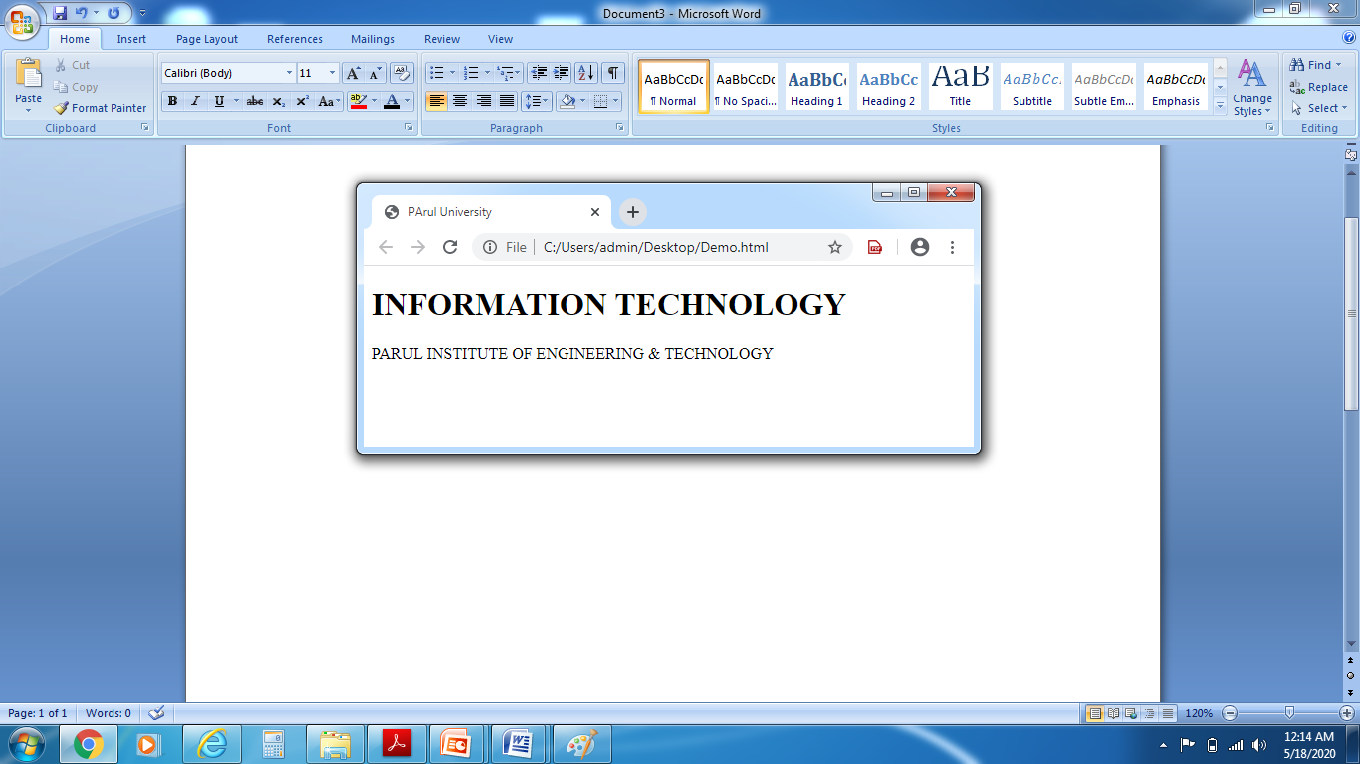
How to create web page?(Contd..)
Step 4: View HTML Page in any Browser
Open the saved HTML file in your favorite browser. The result will look like this:

Slide 8
Text-HTML Formatting Elements
Tag | Format
<i>Parul University</i> | Italic text
<b>..</b> | Bold text
<u>..</u> | Underline
<strong>..</strong> | important text
<small>..</small> | smaller text
<center>..</center> | Text in center
<sub>..</sub> | subscripted text.
<sup>..</sup> | superscripted text
<ins>..</ins> | inserted text
<del>..</del> | deleted text
<mark>..</mark> | marked/highlighted text
<em>..</em> | emphasized text

Slide 9
Text-HTML Formatting Elements-Example
<html>
<head> <title>Welcome</title> </head>
<body>
<p style="color:red">Parul Institute of Engineering &Technology</font></p>
<p><i>Parul Institute of Engineering &Technology</i></p>
<p><b>Parul Institute of Engineering &Technology</b></p>
<p><u>Parul Institute of Engineering &Technology</u></p>
<p><strong>Parul Institute of Engineering &Technology</strong></p>
<p><small>Parul Institute of Engineering &Technology</small></p>
<p>College<sub>Parul Institute of Engineering & Technology</sub>Name</p>
<p>College<sup>Parul Institute of Engineering &Technology</sup>Name</p>
<p>Parul Institute of Engineering &Technology,<ins>Waghodia</ins></p>
<p>Parul Institute of <del>Engineering</del> Technology</p>
<p><em>Parul Institute of Engineering & Technology</em></p>
</body>
</html>

Slide 10
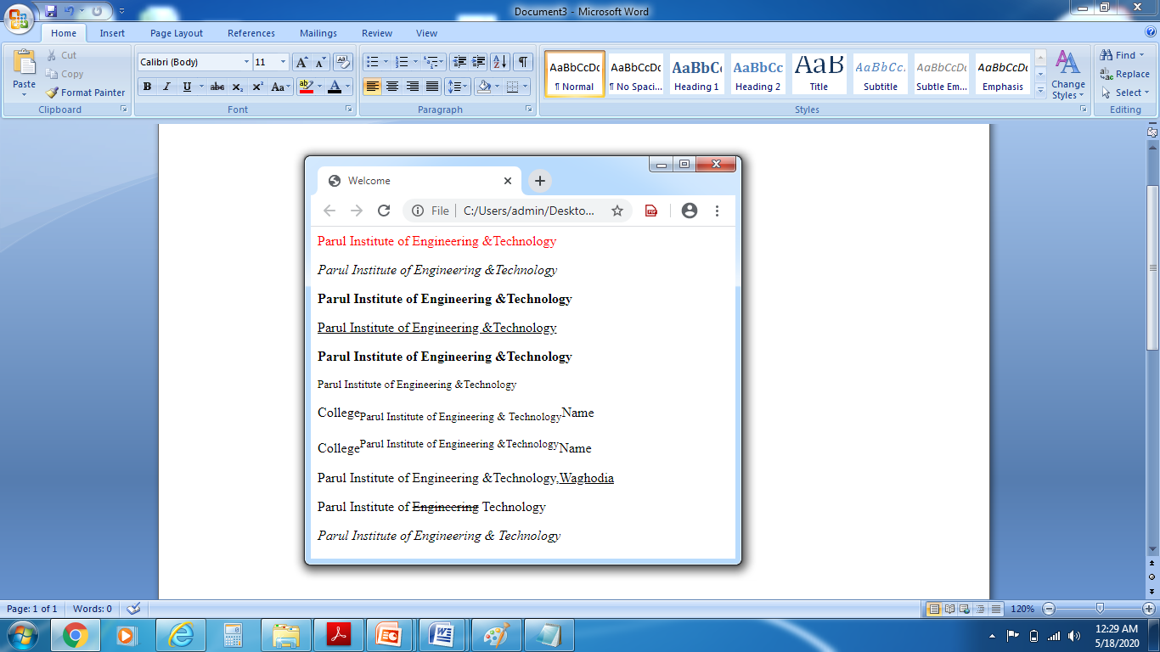
Text-HTML Formatting Elements-Example
OUTPUT:

Slide 11
Hyperlink
A hyperlink (or link) is a word, group of words, or image that you can click on to jump to a new document or a new section within the current document.
When you move the cursor over a link in a Web page, the arrow will turn into a little hand.
Links are specified in HTML using the <a> tag.
The <a> tag can be used in two ways:
To create a link to another document, by using the href attribute
To create a bookmark inside a document, by using the name attribute

Slide 12
HTML Link Syntax
The HTML code for a link is simple. It looks like this:
<a href="url">Link text</a>
The href attribute specifies the destination of a link.
Example:
<a href="http://www.w3schools.com/">Visit W3Schools</a>
which will display like this: Visit W3Schools
Clicking on this hyperlink will send the user to W3Schools' homepage.
Tip: The "Link text" doesn't have to be text. You can link from an image or any other HTML element.

Slide 13
HTML The <img> Tag and the Src Attribute
In HTML, images are defined with the <img> tag.
The <img> tag is empty, which means that it contains attributes only, and has no closing tag.
To display an image on a page, you need to use the src attribute. Src stands for "source". The value of the src attribute is the URL of the image you want to display.
Syntax for defining an image:
<img src="url" alt="some_text"/>

Slide 14
HTML The <img> Tag and the Src Attribute
The URL points to the location where the image is stored. An image named "boat.gif", located in the "images" directory on "www.w3schools.com" has the URL: http://www.w3schools.com/images/boat.gif.
The browser displays the image where the <img> tag occurs in the document. If you put an image tag between two paragraphs, the browser shows the first paragraph, then the image, and then the second paragraph.

Slide 15
HTML The Alt Attribute
The required alt attribute specifies an alternate text for an image, if the image cannot be displayed.
The value of the alt attribute is an author-defined text:
<img src="boat.gif" alt="Big Boat" />
The alt attribute provides alternative information for an image if a user for some reason cannot view it (because of slow connection, an error in the src attribute, or if the user uses a screen reader).

Slide 16
HTML Tables
Tables are defined with the <table> tag.
A table is divided into rows (with the <tr> tag), and each row is divided into data cells (with the <td> tag).
td stands for "table data," and holds the content of a data cell. A <td> tag can contain text, links, images, lists, forms, other tables, etc.

Slide 17
Table Example
Tables are defined with the <table> tag.
Table Example
<table border="1">
<tr>
<td>row 1, cell 1</td>
<td>row 1, cell 2</td>
</tr>
<tr>
<td>row 2, cell 1</td>
<td>row 2, cell 2</td>
</tr>
</table>

Slide 18
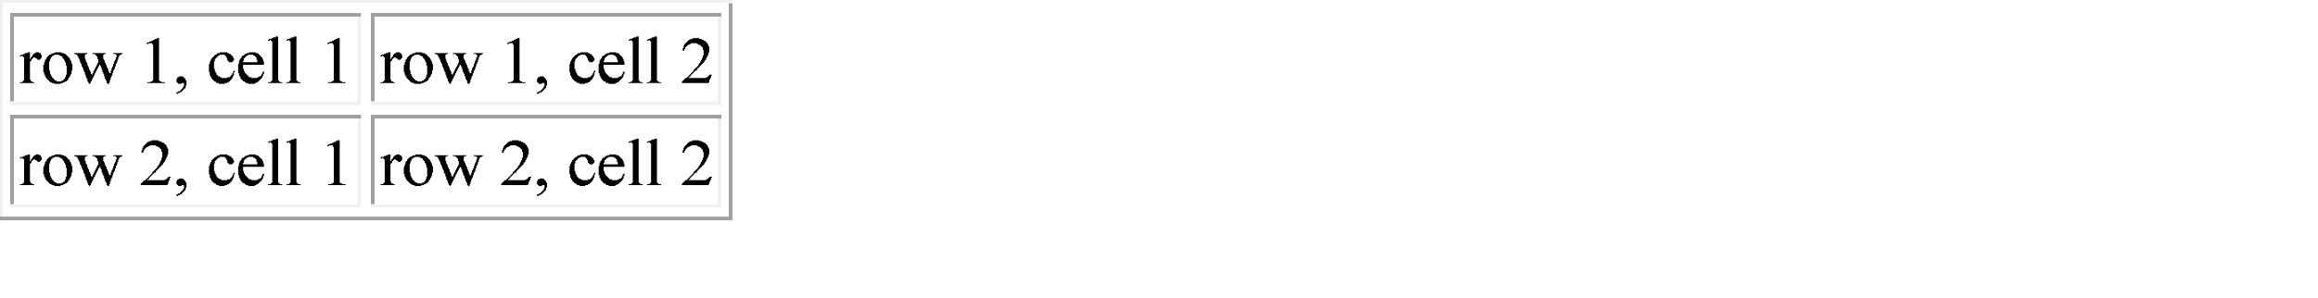
HTML Tables
How the HTML code above looks in a browser:

Slide 19
HTML Tables and the Border Attribute
If you do not specify a border attribute, the table will be displayed without borders. Sometimes this can be useful, but most of the time, we want the borders to show.
To display a table with borders, specify the border attribute:
<table border="1">
<tr>
<td>Row 1, cell 1</td>
<td>Row 1, cell 2</td>
</tr>
</table>

Slide 20
HTML Table Headers
Header information in a table are defined with the <th> tag.
The text in a th element will be bold and centered.
<table border="1">
<tr>
<th>Header 1</th>
<th>Header 2</th>
</tr>
<tr>
<td>row 1, cell 1</td>
<td>row 1, cell 2</td>
</tr>
<tr>
<td>row 2, cell 1</td>
<td>row 2, cell 2</td>
</tr>
</table>

Slide 21
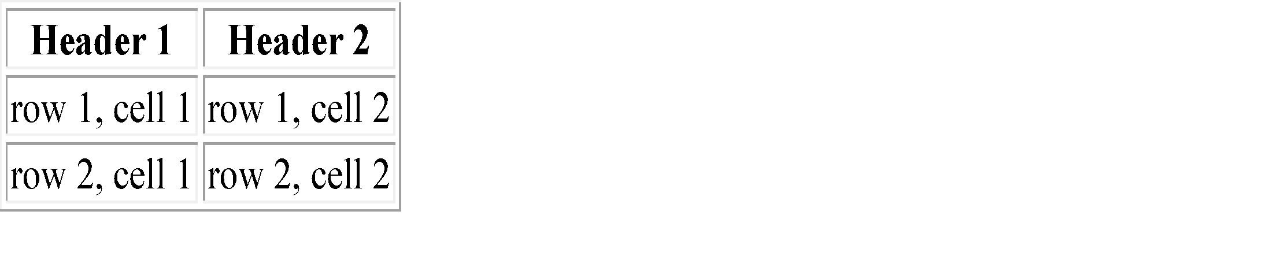
HTML Table Headers
How the HTML code above looks in a browser:

Slide 22
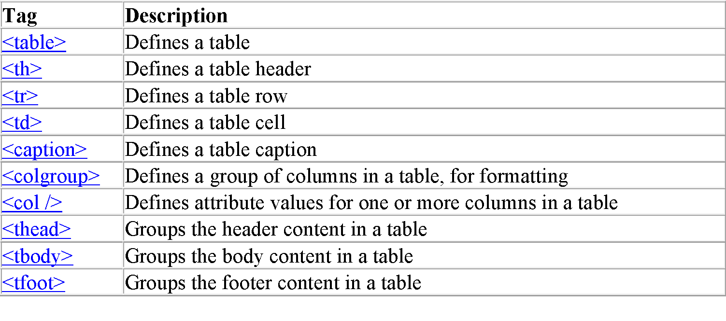
HTML Table Tags

Slide 23
HTML Lists
An ordered list: The first list item The second list item The third list item | An unordered list: List item List item List item

Slide 24
HTML Unordered Lists
An unordered list starts with the <ul> tag. Each list item starts with the <li> tag.
The list items are marked with bullets (typically small black circles).
<ul>
<li>Coffee</li>
<li>Milk</li>
</ul>
How the HTML code above looks in a browser:
• Coffee
• Milk

Slide 25
HTML Ordered Lists
An ordered list starts with the <ol> tag. Each list item starts with the <li> tag.
The list items are marked with numbers.
<ol>
<li>Coffee</li>
<li>Milk</li>
</ol>
How the HTML code above looks in a browser:
1. Coffee
2. Milk

Slide 26
HTML Definition Lists
A definition list is a list of items, with a description of each item.
The <dl> tag defines a definition list.
The <dl> tag is used in conjunction with <dt> (defines the item in the list) and <dd> (describes the item in the list):
<dl>
<dt>Coffee</dt>
<dd>- black hot drink</dd>
<dt>Milk</dt>
<dd>- white cold drink</dd>
</dl>

Slide 27
HTML Definition Lists
How the HTML code above looks in a browser:
Coffee
- black hot drink
Milk
- white cold drink

Slide 28
Forms
HTML forms are used to collect user data/input.
HTML forms contain form elements.
It is defines as a:
<form> … form elements … </form>
Form elements are different types of input elements, checkboxes, radio buttons, submit buttons, and more.

Slide 29
Forms(Contd..)
A.<input> Element:
The <input> element is used for collecting information from the user.
It has many variations, depending on the type attribute.
Type | Description
text | Defines normal text input(accept char. & no. into text box)
Password | Its similar to above text box but anything that is typed cannot be seen.
radio | Defines radio button input (for selecting one of many choices)
submit | Defines a submit button (for submitting the form)
checkbox | This gives a check box that can be toggled between checked & unchecked
Button | This makes a button available

Slide 30
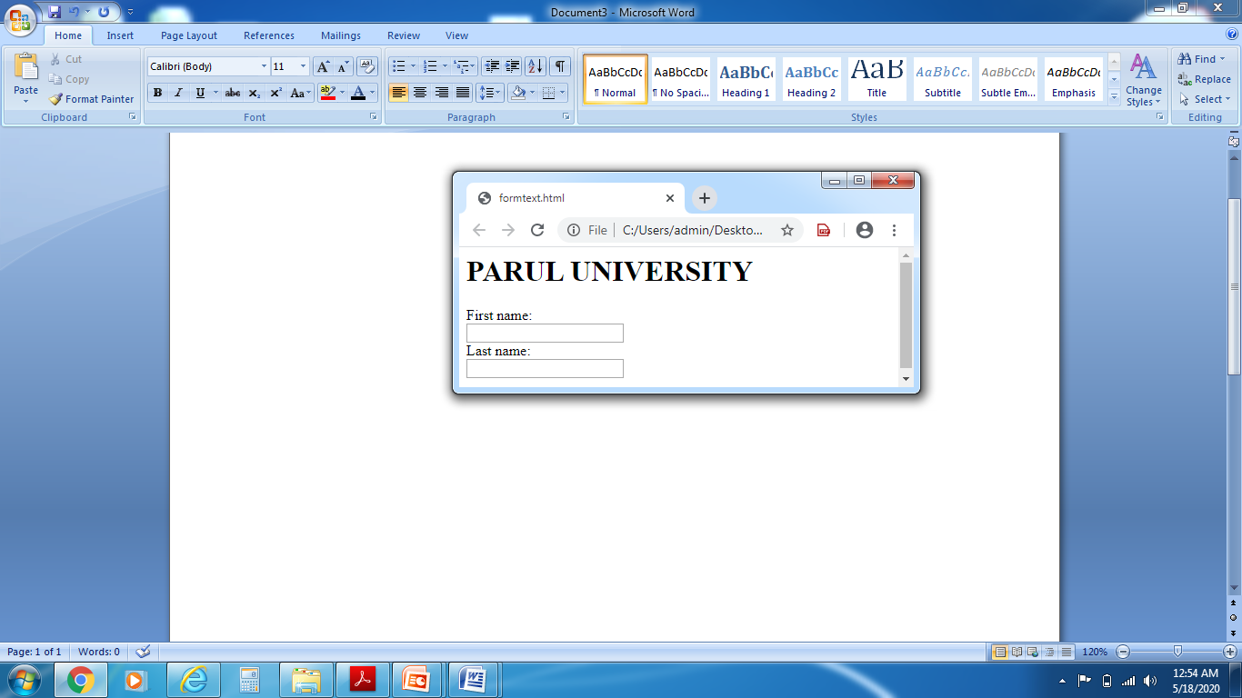
Forms(Contd..)
1.Text Input: It Define a one-line input.(default width of a text field is 20 characters)
<html>
<body>
<h1>PARUL UNIVERSITY</h1>
<form>First name:<br>
<input type="text" name="firstname">
<br>
Last name:<br>
<input type="text" name="lastname">
</form></body>
</html>

Slide 31
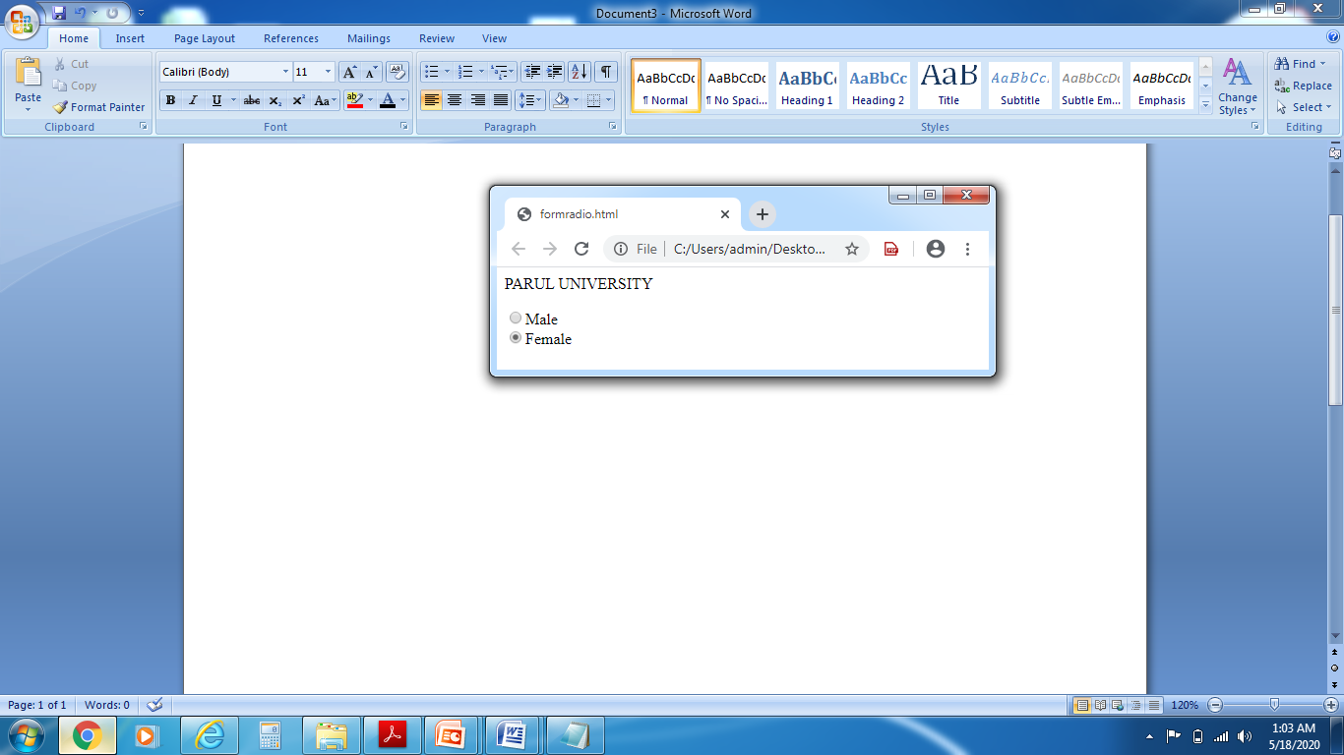
Forms(Contd..)
2. Radio Button Input :It is used to select one of many given choices. you can select only one at same time.
<html>
<body>
<p>PARUL UNIVERSITY</p>
<form>
<input type="radio" name="sex" value="male" >Male
<br>
<input type="radio" name="sex" value="female">Female
</form>
</body>
</html>

Slide 32
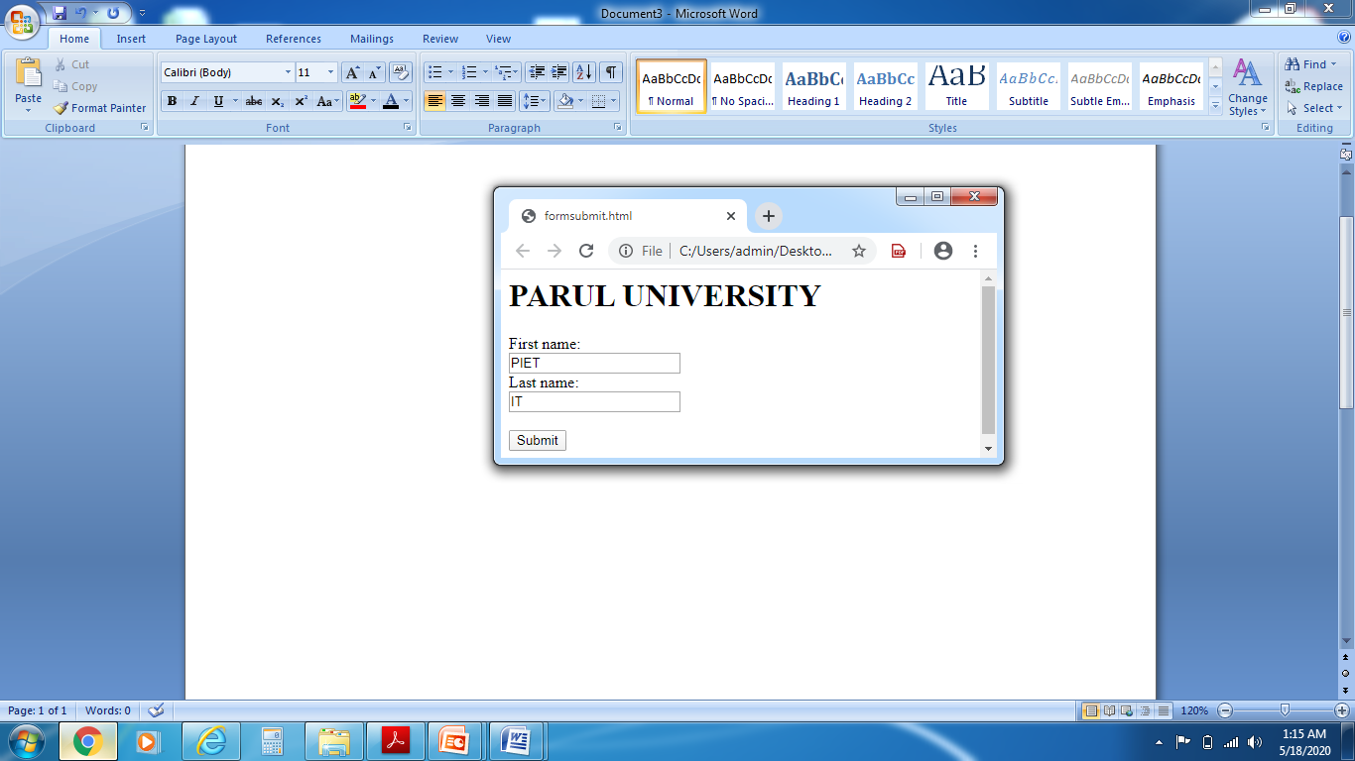
Forms(Contd..)
3. The Submit Button: It is used for submitting a form data to a form-handler.
<html><body>
<form action="action_page.php">
<h1>PARUL UNIVERSITY</h1>
First name:<br>
<input type="text" name="firstname" value="Mickey"><br>
Last name:<br>
<input type="text" name="lastname" value="Mouse"><br><br>
<input type="submit" value="Submit">
</form>
</body>
</html>

Slide 33

Forms(Contd..)
4. checkbox : It is used for select ZERO or MORE options of a limited number of choices.
<html><body>
<form>
<h1> PARUL UNIVERSITY </h1>
<input type="checkbox" name="vehicle" value=“Pen”>I have a Pen <br>
<input type="checkbox" name="vehicle" value=“Pencil”>I have a Pencil<br>
<input type="checkbox" name="vehicle" value=“Eraser">I have a Eraser
<br><br>
<input type="submit">
</form>
</body>
</html>

Slide 34
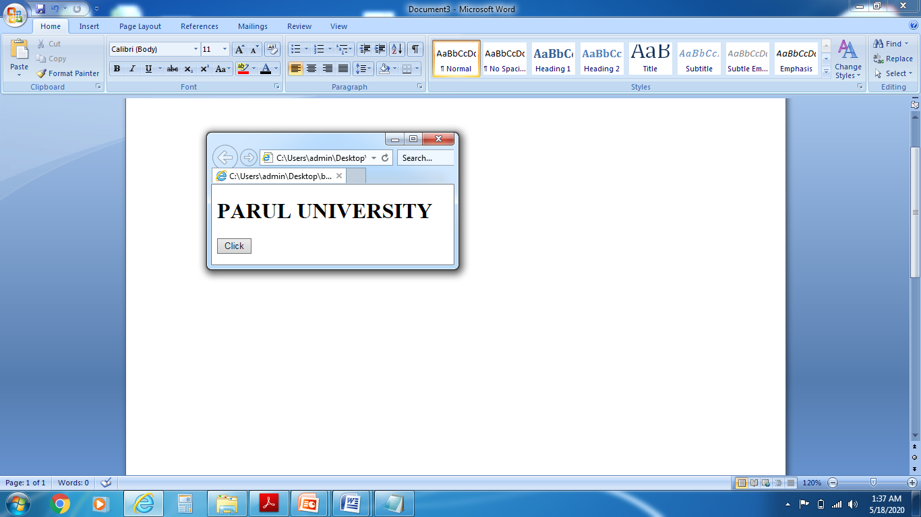
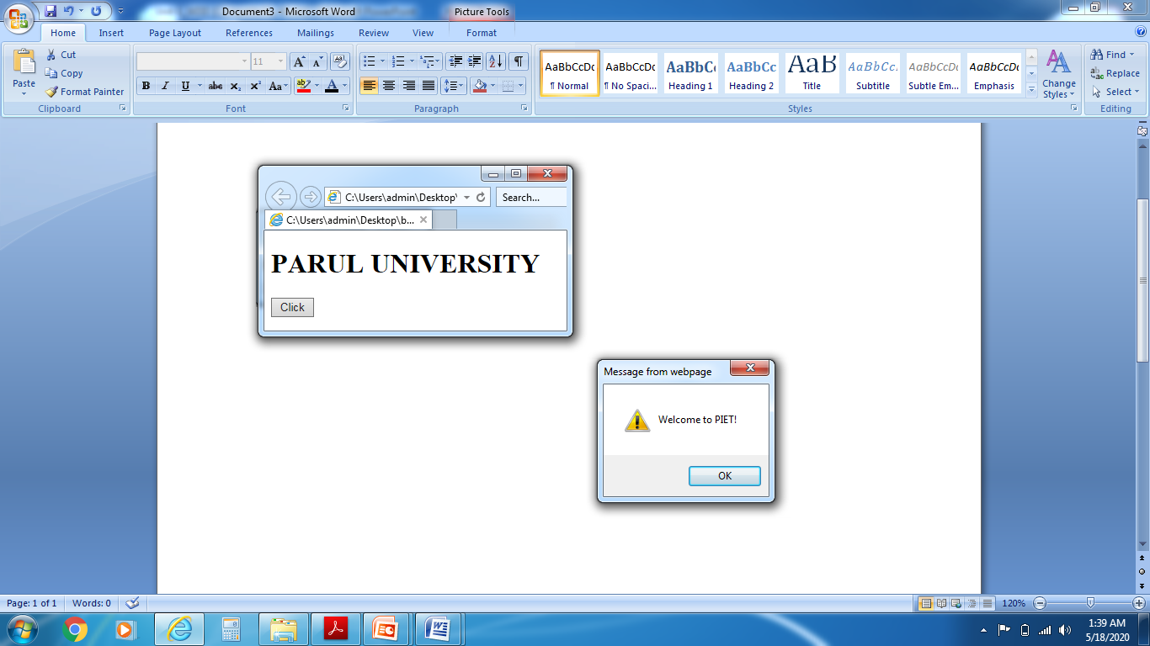
Forms(Contd..)
B. Button: The <button> element represents a clickable button It is used to submit forms.
<html>
<body>
<form>
<h1>PARUL UNIVERSITY</h1>
<button type="button" onclick="alert('Welcome to PIET!')">Click</button>
</form>
</body>
</html>

Slide 35
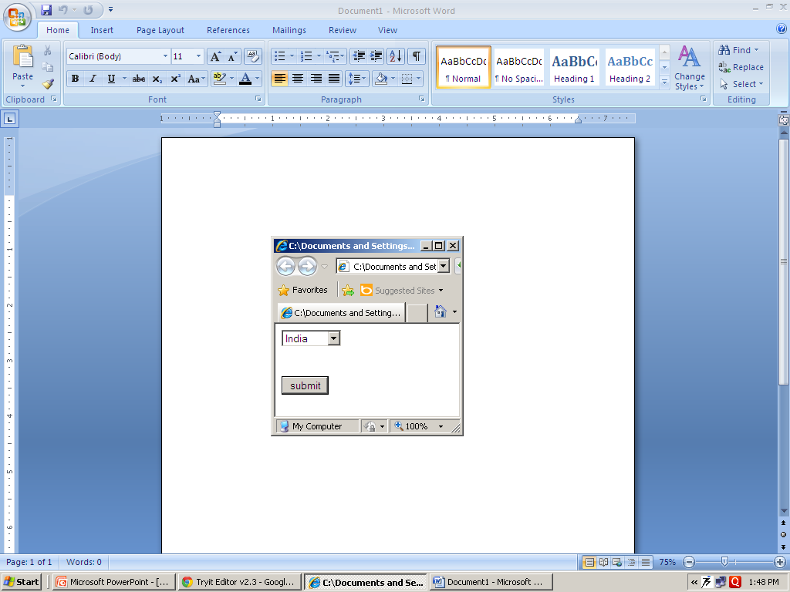
Forms(Contd..)
C.<select>Element(Drop-Down List): HTML <select> tag is used to create drop down list of options
<html><body>
<form>
<select name="country">
<option value="India">India</option>
<option value="canada">canada</option>
<option value="Landon">Landon</option>
<option value="Australia">Australia</option>
</select>
<br><br> <br>
<input type="submit" value="submit">
</form></body>
</html>

Slide 36
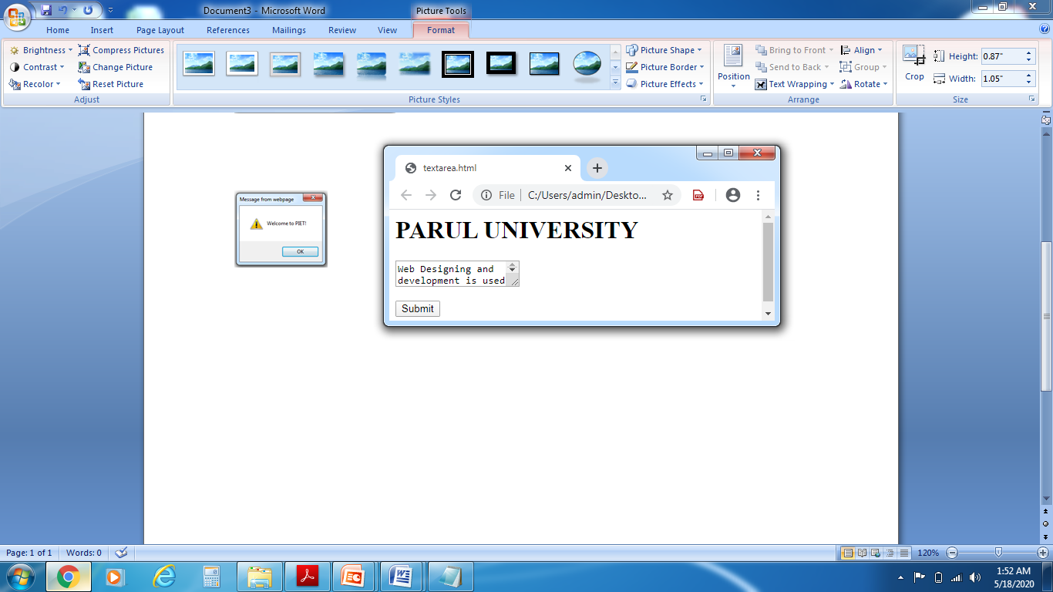
Forms(Contd..)
D.<textarea>Element: It is defines a multi-line input field.
<html><body>
<form>
<textarea name="message" rows=“25" cols=“40">
Web Designing and development is used to create dynamic website.
</textarea>
<br>
<br>
<input type="submit">
</form>
</body>
</html>

Slide 37
HTML Frames
With frames, you can display more than one HTML document in the same browser window. Each HTML document is called a frame, and each frame is independent of the others.
The disadvantages of using frames are:
The web developer must keep track of more HTML documents
It is difficult to print the entire page

Slide 38
The HTML frameset Element
The frameset element holds one or more frame elements. Each frame element can hold a separate document.
The frameset element states HOW MANY columns or rows there will be in the frameset, and HOW MUCH percentage/pixels of space will occupy each of them.

Slide 39
The HTML frame Element
The <frame> tag defines one particular window (frame) within a frameset.
In the example below we have a frameset with two columns.
The first column is set to 25% of the width of the browser window. The second column is set to 75% of the width of the browser window. The document "frame_a.htm" is put into the first column, and the document "frame_b.htm" is put into the second column:
<frameset cols="25%,75%">
<frame src="frame_a.htm" />
<frame src="frame_b.htm" />
</frameset>

Slide 40
HTML Colors
Colors are displayed combining RED, GREEN, and BLUE light
Color Values:
HTML colors are defined using a hexadecimal notation (HEX) for the combination of Red, Green, and Blue color values (RGB).
The lowest value that can be given to one of the light sources is 0 (in HEX: 00). The highest value is 255 (in HEX: FF).
HEX values are specified as 3 pairs of two-digit numbers, starting with a # sign.

Slide 41
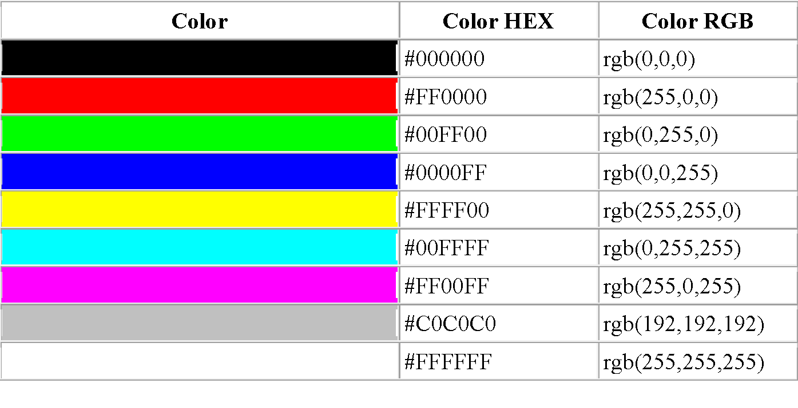
Color Values

Slide 42
HTML5
HTML5 is the latest and most enhanced version of HTML
HTML5 is a standard for structuring and presenting content on the World Wide Web
HTML5 is a cooperation between the World Wide Web Consortium (W3C) and the Web Hypertext Application Technology Working Group (WHATWG)
The new standard incorporates features like video playback and drag-and-drop that have been previously dependent on third-party browser plug-ins such as Adobe Flash, Microsoft Silverlight, and Google Gears

Slide 43
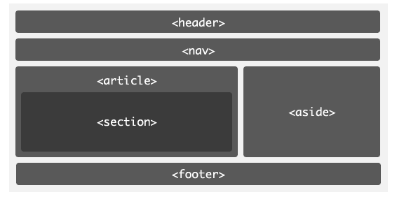
HTML5 Structure

Slide 44
HTML5 Header
The <header> tag in HTML is used to define the header for a document or a section
The header tag contains information related to the title and heading of the related content
A <header> element typically contains:
one or more heading elements (<h1> - <h6>)
logo or icon
authorship information

Slide 45
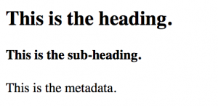
HTML5 Header
<!DOCTYPE html>
<html>
<head>
<title>Header Tag</title>
</head>
<body>
<article>
<header>
<h1>This is the heading.</h1>
<h4>This is the sub-heading.</h4>
<p>This is the metadata.</p>
</header>
</article>
</body>
</html>

Slide 46
HTML5 Footer
The <footer> element defines a footer for a document or section.
A <footer> element typically contains:
authorship information
copyright information
contact information
sitemap
back to top links
related documents
You can have several <footer> elements in one document.

Slide 47
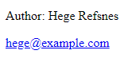
HTML5 Footer
<!DOCTYPE html>
<html>
<body>
<footer>
<p>Author: Hege Refsnes</p>
<p><a href="mailto:hege@example.com">hege@example.com</a></p>
</footer>
</body>
</html>

Slide 48
HTML5 <nav>
The <nav> tag defines a set of navigation links.
NOT all links of a document should be inside a <nav> element.
The <nav> element is intended only for major block of navigation links.
Browsers, such as screen readers for disabled users, can use this element to determine whether to omit the initial rendering of this content.

Slide 49
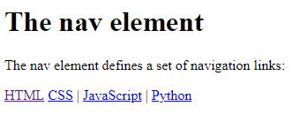
HTML5 <nav>
<nav>
<a href="/html/">HTML</a> | <a href="/css/">CSS</a> | <a href="/js/">JavaScript</a> | <a href="/python/">Python</a>
</nav>

Slide 50
HTML5 article
The <article> tag is one of the new sectioning element in HTML5
The HTML <article> tag is used to represent an article
More specifically, the content within the <article> tag is independent from the other content of the site (even though it can be related)
Potential source for Article Element are :
A blog entry
A magazine/newspaper article
A forum post
A user submitted comment

Slide 51
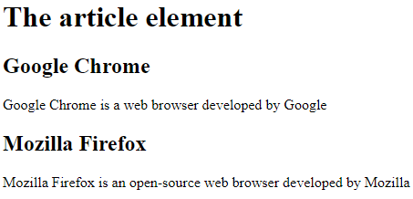
HTML5 article
<!DOCTYPE html>
<html>
<body>
<h1>The article element</h1>
<article>
<h2>Google Chrome</h2>
<p>Google Chrome is a web browser developed by Google</p>
</article>
<article>
<h2>Mozilla Firefox</h2>
<p>Mozilla Firefox is an open-source web browser developed by Mozilla</p>
</article>
</body>
</html>

Slide 52
HTML5 section
The <section> element defines a section in a document.
According to W3C's HTML documentation: "A section is a thematic grouping of content, typically with a heading."
A web page could normally be split into sections for introduction, content, and contact information.

Slide 53
HTML5 section
<!DOCTYPE html>
<html>
<body>
<section>
<h1>WWF</h1>
<p>The World Wide Fund for Nature (WWF) is an international organization working on issues regarding the conservation, research and restoration of the environment, formerly named the World Wildlife Fund. WWF was founded in 1961.</p>
</section>
<section>
<h1>WWF's Panda symbol</h1>
<p>The Panda has become the symbol of WWF. The well-known panda logo of WWF originated from a panda named Chi Chi that was transferred from the Beijing Zoo to the London Zoo in the same year of the establishment of WWF.</p>
</section>
</body>
</html>

Slide 54
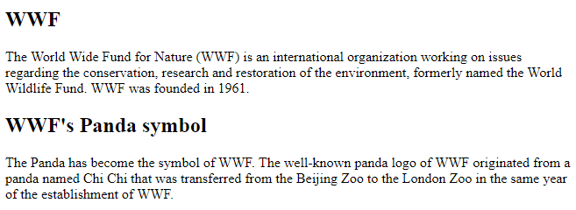
HTML5 section

Slide 55
Audio & Video Tag
HTML 5 support multimedia elements : <audio> and <video>.
We can add sound, music, videos, movies and animations on the web/website.
Multimedia elements Like audio and video are stored in media files.
It is used different extension like: .mpg, .mp3, .mp4, .ogg, .rm, .ram, .webm, .wav etc
HTML5 support Only MP3, Wav, ogg format for audio.
HTML5 support Only MP4, WebM, ogg format for video

Slide 56
Audio & Video Tag(Contd..)
Audio: Use src attribute to identify the media source and add a controls attribute so the user can play and pause the media.
<html>
<body>
<p>PARUL UNIVERSITY </p>
<audio width="100%" height="100%" controls="controls">
<source src=“horse.mp3" type=audio/mp3>
<source src=“audio.ogg” type=“audio/ogg”>
</audio>
</body>
<html>

Slide 57
Audio & Video Tag(Contd..)
Video:
<html>
<body>
<video width=“300” height=“200” controls>
<source src=“movie.mp4” type=“video/mp4”>
<source src=“movie.ogg” type=“video/ogg”>
</video>
</body>
<html>

Slide 58
Audio & Video Tag(Contd..)
Attributes | Description
autoplay | The video/audio will automatically start without stopping to finish loading the data.
controls | User can control audio/video like pause/resume, volume, seeking etc.
autobuffer | The audio/video will automatically begin buffering even don’t set to automatically play.
height | It is specifies the height of the audio/video’s display area.
src | Use src attribute to identify the media source. This is optional. we can use <source> within the video block .
width | It is specifies the width of the audio/video’s display area.(in CSS pixels)
loop | It will allow audio/video automatically seek back to the start after reaching at the end.
poster | This is a URL of an image to display until the user plays or seeks.
preload | It is specifies the audio/video will be loaded at page load, and ready to run. if autoplay is present then ignore this.

Slide 59
Canvas
HTML 5 support graphics elements : <canvas> and <svg>.
The use of <canvas> element is to draw graphics on a web.
The<canvas> element is only a container for graphics. You must use JavaScript to actually draw the graphics.
By default, a canvas has no border and no content. A canvas is a rectangular area on an HTML page.
Ex. <canvas id=“parul" width=“90“ height=“80"></canvas>
Canvas has no. of methods for drawing paths, boxes, circles, text, and adding images.
We can find <canvas> element in the DOM using getElementById() method like:
var canvas = document.getElementById("mycanvas");

Slide 60
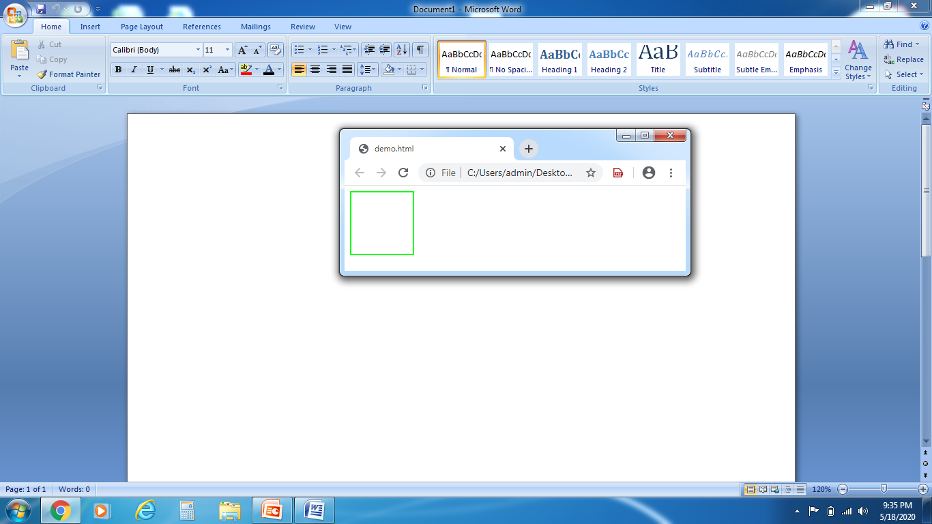
Canvas(Contd..)
Example: <!DOCTYPE html>
<html> <head>
<style>
#parul
{ border:2px solid green; }
</style>
</head>
<body>
<canvas id=“parul" width=“90“ height=“90">
</canvas>
</body>
</html>

Slide 61
Data Storage
Web applications can store data locally within the user's browser.
Before HTML5, application data had to be stored in cookies, included in every server request.
Web storage is more secure, and large amounts of data can be stored locally, without affecting website performance.
HTML Web storage provides two objects for storing data on the client:
1. Window.localStorage- store data with no expiration date .
2.Window.sessionStorage- store data for one session(data is lost when the browser tab is closed)

Slide 62
Data Storage(Contd..)
Check browser support for localStorage and sessionStorage, Before using web storage
if(typeof(Storage)!=="undefined")
{ // Code for Storage. }else { // Sorry! No Web Storage support.. }
1.The local Storage Object:
The local Storage object stores the data with no expiration date.
The data will not be deleted when the browser is closed, and will be available the next day, week, or year.

Slide 63
Data Storage(Contd..)
Example
<html>
<body>
<div id=“parul"></div>
<script>
if (typeof(Storage) !== "undefined") { // Check browser support
localStorage.setItem(“Fiestname", “Hiren"); // Store information
document.getElementById(“parul").innerHTML = localStorage.getItem(“Firstname"); // get information
}
else {
document.getElementById(“parul").innerHTML = “Opps, your browser does not support Web Storage...";
}
</script> </body>
</html>

Slide 64
Data Storage(Contd..)
The previous example could also be written like this:
localStorage.Firstname= “Hiren"; // For data Store document.getElementById("result").innerHTML = localStorage.lastname; // get Data
The syntax for removing the “Firstname" localStorage item is as follows:
localStorage.removeItem(“Firstname");

Slide 65
Data Storage(Contd..)
2. The sessionStorage Object:
It stores the data for only one session. The data is deleted when the user closes the browser tab.
The following example counts the number of times a user has clicked a button, in the current session:

Slide 66
Data Storage(Contd..)
Example: <html> <head><script>
function Counter() {
if(typeof(Storage) !== "undefined") {
if (sessionStorage.clickcount) {
sessionStorage.clickcount =Number(sessionStorage.clickcount)+1; }
else {
sessionStorage.clickcount = 1; }
document.getElementById(“parul").innerHTML = "You have clicked the button " + sessionStorage.clickcount + " times in this session."; }
else {
document.getElementById(“parul").innerHTML = “Opps, browser does not support web storage..."; } }
</script></head>
<body>
<p><button onclick="Counter()" type="button">Click me!</button></p>
<div id=“parul"></div>
</body> </html>

Slide 67
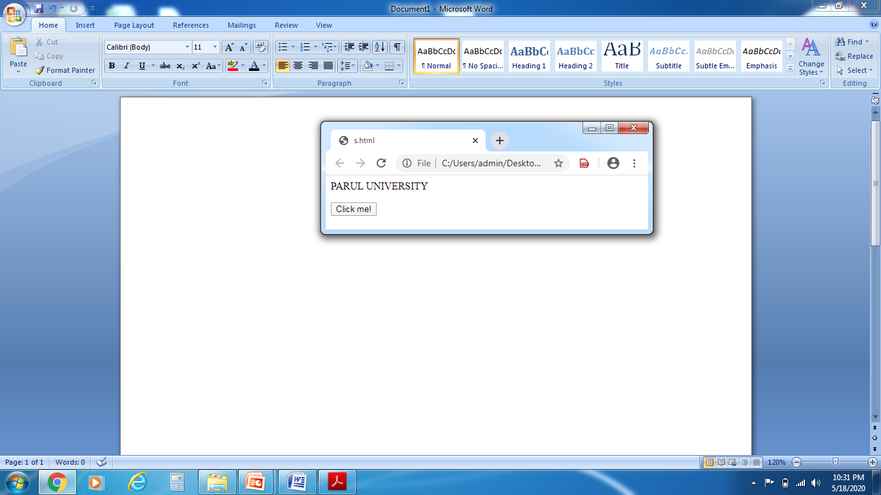
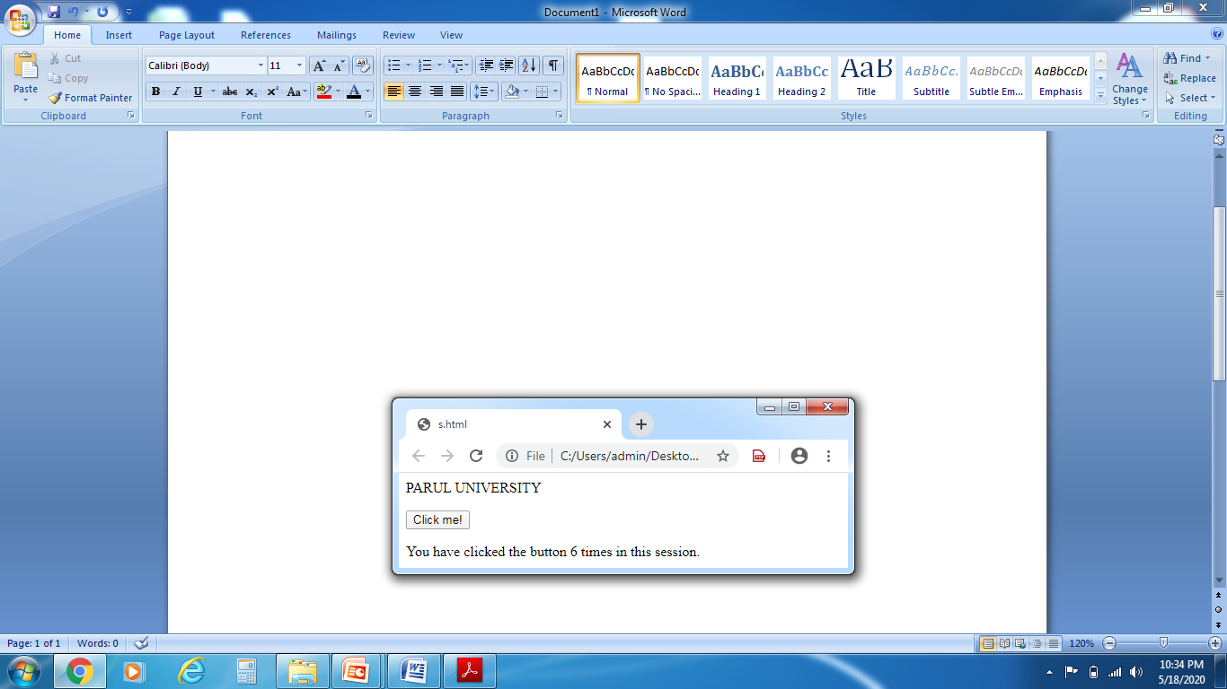
Data Storage(Contd..)
OUTPUT:

Slide 68
Offline
onoffline Event Attribute:
When the browser starts to work offline then Execute a JavaScript
The onoffline attribute fires when the browser starts to work offline.
<body onoffline="myFunction()">

Slide 69
Offline(Contd..)
Example :<html>
<body onoffline="offFun()“ ononline="onFun()" >
<p>Information Technology-PIET</p>
<p>This both events are only supported in Firefox and Internet Explorer version 8 to 10</p>
<script>
function onFun()
{
alert ("Your browser is working online.");
}
function offFun() {
alert ("Your browser is working offline.");
}</script> </body> </html>

Slide 70
Geolocation
It is use to share your location with your web sites.
Most of the browsers and mobile devices support Geolocation API.
A JavaScript can capture your latitude and longitude and can be sent to backend web server and display your location on a map.
It is work with a new property of the global navigator object.
we can be create Geolocation object as below:
var geolocation = navigator.geolocation;

Slide 71
Geolocation(Contd..)
Navigator Object Properties:
Property | Description
appName | Return the name of the browser
appVersion | Return the version information of the browser
geolocation | Return a geolocation object that can be used to locate the user’s position
appCodeName | Return the code name of the browser
language | Return the language of the browser
platform | Return for which platform the browser is compiled
onLine | Verify whether the browser is online
cookieEnabled | Determines whether cookies are enabled in the browser
product | Return the engine name of the browser

Slide 72
Geolocation(Contd..)
Geolocation Object also provides below Methods:
Methods | Description
watchPosition() | Retrieves periodic updates about the current geographic location of the device.
clearWatch() | Delete an ongoing watchPosition Call.
getCurrentPosition() | Retrieves the current geographic location of the user.

Slide 73
Geolocation(Contd..)
sample code to use any of the above method −
function getLoc()
{
var geolocation = navigator.geolocation;
geolocation.getCurrentPosition(showLocation, errorHandler);
}
showLocation and errorHandler are callback methods which is used to get actual position and to handle errors if there is any.
The getCurrentPosition() is used to return the User’s Position.

Slide 74
Geolocation(Contd..)
Location Properties:
The Position object which stores the complete location information. It specifies the current geographic location of the device. The following are the properties of the Position object:
Property | Type | Description
coords | objects | Specifies the geolocation of the device.
coords.longitude | Number | Specifies the longitude estimate in decimal degrees. Range is[-180.00, +180.00]
coords.latitude | Number | Specifies the latitude estimate in decimal degrees. Range is[-90.00, +90.00]
coords.altitude | Number | Specifies the altitude estimate in meters. It’s Optional.
coords.speed | Number | Specifies the device’s current ground speed in meters per second. It’s Optional.
coords.heading | Number | Specifies the device’s current direction of movement in degrees counting clockwise relative to true north. It’s Optional.
coords.accuracy | Number | Specifies the accuracy of the latitude and longitude estimate in meters. It’s Optional.
timestamp | date | Specifies the time when the location information was retrieved and position object created. It’s Optional.
coords.altitudeAccuracy | Number | Specifies the accuracy of the altitude estimate in meters. It’s Optional.

Slide 75
Geolocation(Contd..)
This is a sample code of Position object. Here showLocation method is a callback method
function showLocation( position )
{
var lati = position.coords.latitude;
var long = position.coords.longitude;
...
}

Slide 76
Geolocation(Contd..)
Handling Error
Geolocation is complicated, so its required to catch any error and handle it.
The geolocations methods getCurrentPosition() and watchPosition() make use of an error handler callback method which gives PositionError object.
There are two Handling Error properties :
Property | Type | Description
Message | String | Contains a human-readable description of the error
Code | Number | Contains a numeric code for error

Slide 77
Geolocation(Contd..)
Below table describe the Possible error code return in the PositionError Object:
Constant | Code | Description
UNKNOWN_ERROR | 0 | The method failed to retrieve the location of the device due to an unknown error.
PERMISSION_DENIED | 1 | The method failed to retrieve the location of the device because the application does not have permission to use the location services.
POSITION_UNAVAILABLE | 2 | The location of the device could not be determined.
TIMEOUT | 3 | The method was unable to retrieve the location information within the specified maximum timeout interval.

Slide 78
Geolocation(Contd..)
This is a sample code of PositionError object.Here errorHandler method is a callback method :
function errorHandler( err )
{
if (err.code == 0)
{
// Unkonwn_Error
}
}

Slide 79
Geolocation(Contd..)
Position Options:
The actual syntax of getCurrentPosition() method is:
getCurrentPosition(callback, ErrorCallback, options)
Here 3rd argument is PositionOptions object which specifies a set of options for retrieving the geographic location of the device.
Below table describe the option for third argument:
Property | Type | Description
timeout | Number | It is the number of milliseconds your web application is willing to wait foe a position.
maximumAge | Number | Specifies the expiry time in milliseconds for caches location information.
enableHighAccuracy | Boolean | Specifies whether the widget wants to receive the most accurate location estimate possible. By default it is false.

Slide 80
Geolocation(Contd..)
This is a sample code which define how to use above mentioned methods −
function getLocation()
{
var geolocation = navigator.geolocation; geolocation.getCurrentPosition(showLocation, errorHandler, {maximumAge: 75000});
}

Slide 81
Geolocation(Contd..)
Example: <html><body>
<p>PARUL UNIVERSITY </p>
<p>PARUL INSTITUTE OF ENGINERRING & TECHNOLOGY</p>
<button onclick="getLoc()">Get Location</button>
<p id=“parul">
</p>
<script>
var a = document.getElementById(“parul");
function getLoc() {
if (navigator.geolocation) {
navigator.geolocation.getCurrentPosition(showPos, DisplayError) }
else {
a.innerHTML = “Opps,Geolocation is not supported."; } }
function showPos(position)
{
a.innerHTML = "Latitude: " + position.coords.latitude + "<br>Longitude: " + position.coords.longitude;
}

Slide 82
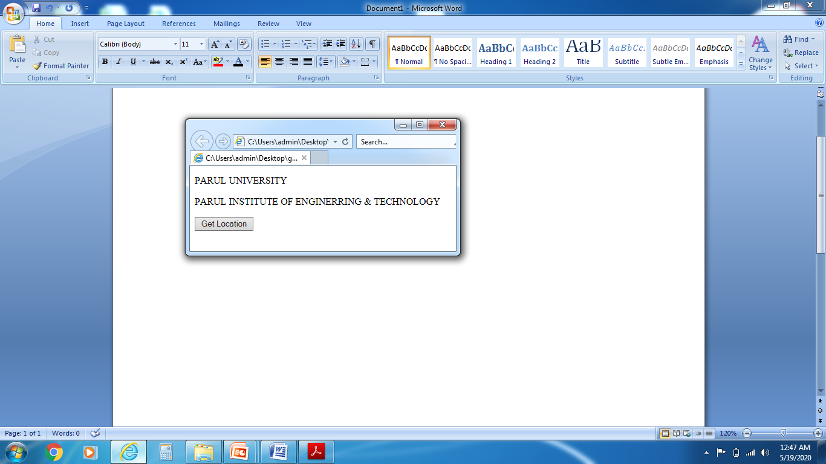
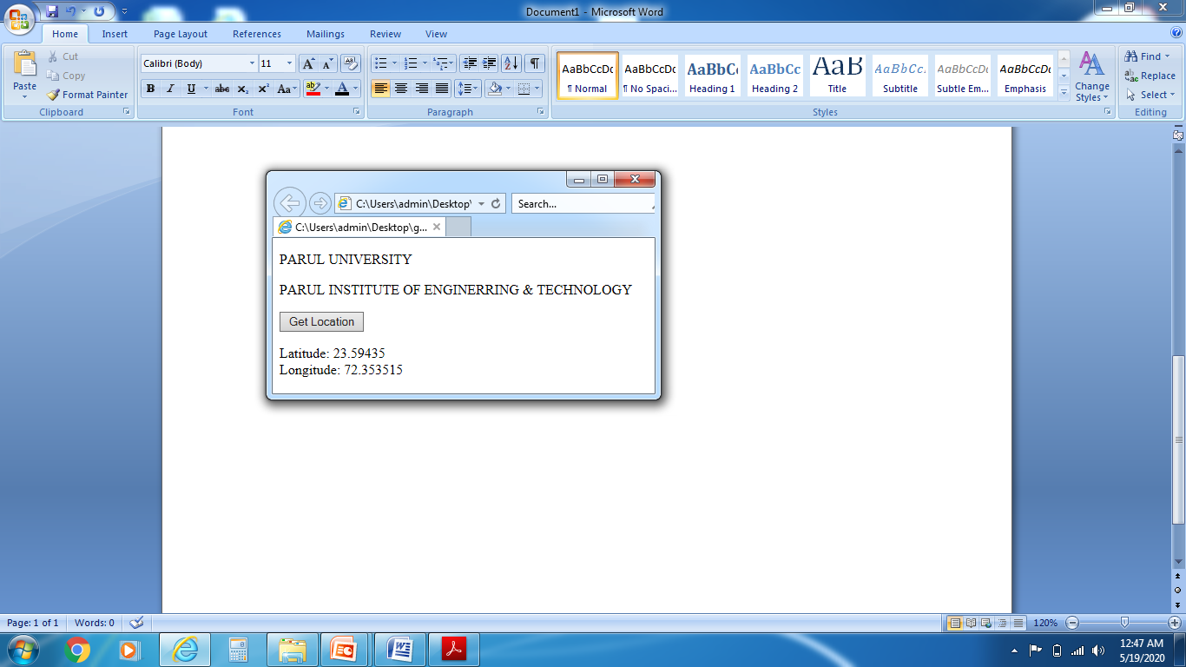
Geolocation(Contd..)
function DisplayError(error)
{
switch(error.code)
{
case error.PERMISSION_DENIED:
a.innerHTML = "denied the request."
break;
case error.POSITION_UNAVAILABLE:
a.innerHTML = "Location information is not available."
break;
case error.TIMEOUT:
a.innerHTML = "get user location timed out."
break;
case error.UNKNOWN_ERROR:
a.innerHTML = "An unknown error occurred."
break; } }</script></body></html>

Slide 83
Drag & Drop
In HTML5, any element can be draggable.
It is when you "grab" an object and drag it to a different location.
Drag and Drop (DnD) allows the user to click and hold the mouse button down over an element, drag it to another location, and release the mouse button to drop the element there.
To make an element draggable, set the draggable attribute to true:
<img draggable="true">

Slide 84
Drag & Drop (Contd..)
ondragstart & setData(): (What to Drag)
what happen when the element is dragged.
The ondragstart attribute calls a function, drag(event), that specifies what data to be dragged.
The dataTransfer.setData() method sets the data type and the value of the dragged data:
function drag(e)
{ e.dataTransfer.setData("text", e.target.id); }
Here, the data type is "text" and the value is the id of the draggable element ("drag1").

Slide 85
Drag & Drop (Contd..)
ondrop: (Do the Drop )
When the dragged data is dropped, a drop event occurs.
The ondrop attribute calls a function, drop(event):
function drop(e)
{ e.preventDefault(); var data = e.dataTransfer.getData("text"); e.target.appendChild(document.getElementById(data)); }

Slide 86
Drag & Drop (Contd..)
Example : <html><head><style>
#parul {
width: 190px;
height: 80px;
padding: 10px;
border: 1px solid #aaaaaa; }
</style><script>
function allowDrop(e) {
e.preventDefault(); }
function drag(e) {
e.dataTransfer.setData("text", e.target.id); }
function drop(e) {
e.preventDefault();
var data = e.dataTransfer.getData("text");
e.target.appendChild(document.getElementById(data));
}</script></head>

Slide 87
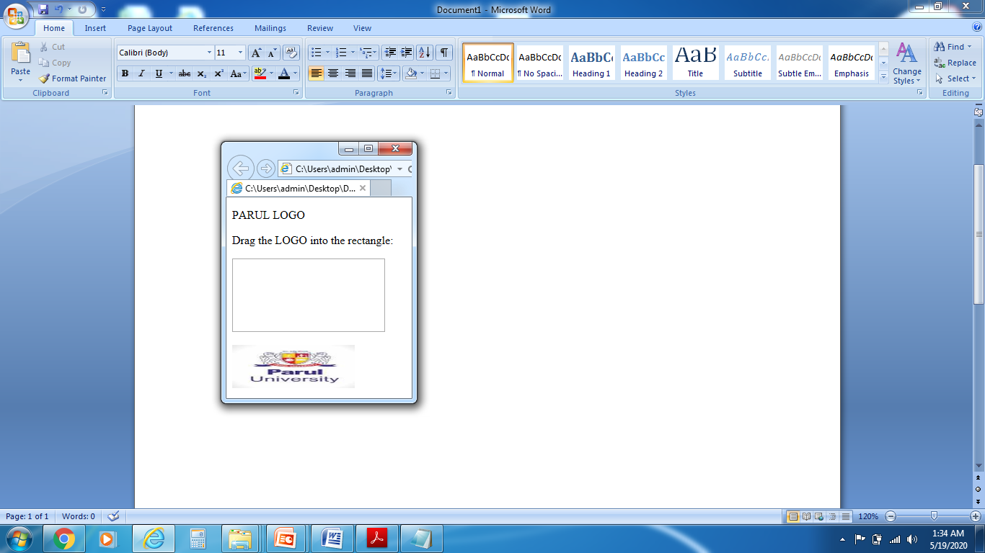
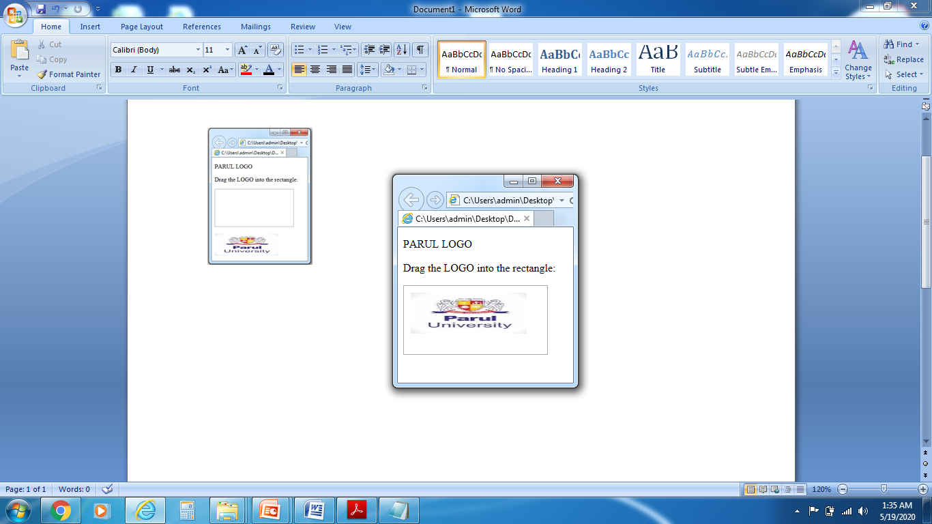
Drag & Drop (Contd..)
<body><p> PARUL LOGO</p>
<p>Drag the image into the rectangle:</p>
<div id="parul" ondrop="drop(event)" ondragover="allowDrop(event)"></div><br>
<img id="drag1" src="parullogo.jpg" draggable="true" ondragstart="drag(event)" width=“170" height=“60">
</body>
</html>

Slide 88
Drag & Drop (Contd..)
There are no. of Drag & Drop events, which are listed below:
Events | Description
dragenter | Fired when the mouse is first moved over the target element while a drag is occurring.
dragleave | Fired when the mouse leaves an element while a drag is occurring.
dragstart | Fired when the user start dragging of the object.
dragover | Fired as the mouse is moves over an element when a drag is occurring
drag | Fires every time the mouse is moved while the object is being dragged.
draged | Fires when the user releases the mouse button while dragging an object.
drop | Fired on the element where the drop was occurred at the end of the drag operation

Slide 89
Message
Using web messaging we can pass the data across as a message event.
Example you want to send the data from one page to ad container which is placed at iframe or vice-versa, in this scenario, Browser throws a security exception.
Message Event attributes:
Attributes | Description
Source | Contains to A reference to the originating document’s window
ports | Contains the data which is sent by any message port
data | Contains string information/data
origin | Contain Domain name and port
lastEventId | Contains unique identifier for the current message event.

Slide 90
Message(Contd..)
Before send message, we need to create a new web browsing context either by creating new window or new iframe .
We can send the data using with postMessage() and it has two arguments.
targetOrigin − Origin name
message − The message to send

Slide 91
Message(Contd..)
Passing message from iframe to button
var iframe = document.querySelector('iframe');
var button = document.querySelector('button');
var clickHandler = function()
{
iframe.contentWindow.postMessage('The message to send.','https://www.gmail.com);
}
button.addEventListener('click',clickHandler,false);

Slide 92
Message(Contd..)
B. Retrieving a cross-document message in the receiving document.
var messageEventHandler = function(event)
{
if(event.origin == 'https://www.gmail.com')
{
alert(event.data);
}
}
window.addEventListener('message',messageEventHandler,false);

Slide 93
Message(Contd..)
Channel Message:
channel messaging is a two way communication between the browsing contexts.
It uses MessageChannel and MessagePort Objects
When creating messageChannel, it internally creates two ports to sending the data and forwarded to another browsing context.
postMessage() − Post the message via channel
start() − It send the data
close() − it close the port

